Slide 1
INTEL: Optimization of the
“Catch & Win”
Marketing Campaign
February 11th, 2020
Yevheniya Boyko
Michael Abramson
Santiago Romero
Sophie Briques
Junjie Huang

Slide 2




Context & PROBLEM Statement
“Catch & Win” Asia –Pacific marketing campaign for product category, Ultrabooks
Goal: Engage end-users through online raffle
Marketing Agency produced preliminary plan for end-users
Budget allocation of $95,000 reduced to $86,450
Campaign can be optimized with Intel’s past internal data based on click through rates and cost per impression
Notes:
Mention the budget
Mention the fee

Slide 3

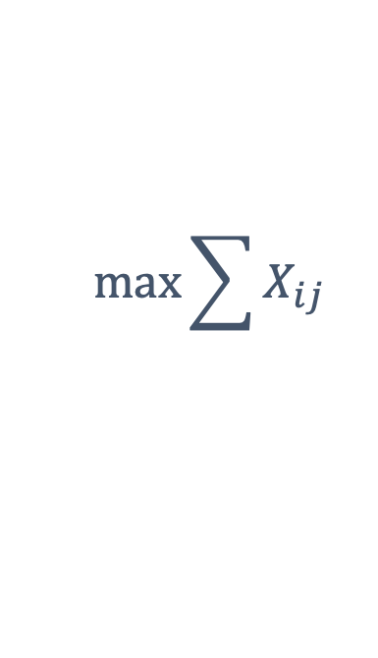
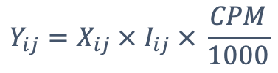
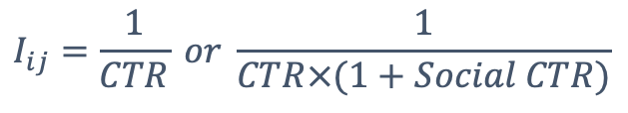


Data & Methodology
Linear Programming Model
Let
$$X_{ij}$$
denote the clicks for platform j in country i
Hence, costs:
Objective Function:
$$Y_{ij}=X_{ij} × I_{ij} × \frac{CPM}{1000}$$
$$\max{\sum{X_{ij}}}$$
Subject to:
Parameter for budget allocation:
$$75\% × Original Cost ≤ Y_{ij} ≤125\% × Original costs$$
$$Y_{ij} ≤Original Total Cost$$
$$I_{ij}=\frac{1}{CTR} or \frac{1}{CTR×(1+Social CTR)}$$
$$clicks should be integer$$
* Assumption: campaign timeline is consistent with the expected number of clicks
Notes:
Let me explain how we build our model,
We use Xij denote the clicks for platform j in country i, where i=1,2,3,4,5,6 for Indonesia,Korea,Malaysia,Pakistan,Phillipines and Singapore, j=1,2,3 represent for Marketplace, Premium and Mobile platform
In this model, We are heading to Maximize the total clicks（EXij）And then to figure out how much cost we should distribute into different part, we set impression per click as the parameter, we use Iij denote it, and it equals to 1/CTR or 1/CTR*(1+CTR)
Hence the cost for each part(Yij) equals to the impression for each part times CPM devided by 1000
Based on the new market plan we set our new constraints: the new impression for each part range from75 to 125% of Original one, the new total cost is less or equals to Original Total Cost minus agent fee, and all the clicks must be integer
Also, we set that the simulation is in a ideal environment which means timeline will be consistent with the number of clicks before the end of the campaign
Let Xij denote the clicks for platform j in country i, where i=1,2,3,4,5,6 for Indonesia,Korea,Malaysia,Pakistan,Phillipines and Singapore, j=1,2,3 for Marketplace, Premium and Mobile
Objective Function: Max total clicks: EXij
To figure out how much cost we should distribute into different part, we set impression per click as the parameter, we use Iij denote it, and Iij=1/CTR or Iij=1/CTR*(1+CTR)
Hence the cost for each part(Yij) is Yij=Xij*Iij*CPM/1000
Based on the constraints: 75%*Original Cost for Each Part<=Yij<= 125%*Original Cost for Each Part, Yji<=Original Total Cost, and all the clicks should be integer
Assumptions:
timeline will be consistent with the number of clicks we aim to get before the end of the campaign

Slide 4
Original Marketing Plan
 | Indonesia | Korea | Malaysia | Pakistan | Phillipines | Singapore | Total
Marketplace
Impressions | 6,000,000 | 6,000,000 | 6,000,000 | 1,000,000 | 6,000,000 | 2,000,000 | 27,000,000
CPM($) | 0.5 | 0.9 | 0.6 | 0.6 | 0.6 | 0.7 | 0.6
Cost($) | 3,180 | 5,280 | 3,600 | 570 | 3,360 | 1,420 | 17,410
Premium
Impressions | 3,500,000 | 3,700,000 | 3,700,000 | 700,000 | 3,700,000 | 1,350,000 | 16,650,000
CPM($) | 4.4 | 5.3 | 3.2 | 4.4 | 3.9 | 5.6 | 4.3
Cost($) | 15,435 | 19,425 | 11,914 | 3,087 | 14,245 | 7,560 | 71,666
Mobile Ads
Impressions | 3,000,000 | - | 3,000,000 | 3,000,000 | 3,000,000 | 3,000,000 | 15,000,000
CPM($) | 0.4 | - | 0.4 | 0.4 | 0.4 | 0.4 | 0.4
Cost($) | 1,200 | - | 1,200 | 1,200 | 1,200 | 1,200 | 1,200
Total Ads
Impressions | 12,500,000 | 9,700,000 | 12,700,000 | 4,700,000 | 12,700,000 | 6,350,000 | 58,650,000
Cost($) | 19,815 | 24,705 | 16,714 | 4,857 | 18,805 | 10,180 | 95,076

Slide 5
Optimized Marketing Plan
 | Indonesia | Korea | Malaysia | Pakistan | Phillipines | Singapore | Total
Marketplace
Impressions | 7,500,000 | 4,500,000 | 7,500,000 | 1,250,000 | 7,500,000 | 2,500,000 | 30,750,000
CPM($) | 0.5 | 0.9 | 0.6 | 0.6 | 0.6 | 0.7 | 0.6
Cost($) | 3,975 | 3,960 | 4,500 | 713 | 4,200 | 1,775 | 19,123
Premium
Impressions | 2,625,060 | 2,775,407 | 2,775,118 | 874,870 | 3,966,130 | 1,012,645 | 14,029,230
CPM($) | 4.4 | 5.3 | 3.2 | 4.4 | 3.9 | 5.6 | 4.3
Cost($) | 11,577 | 14,571 | 8,936 | 3,858 | 15,270 | 5,671 | 59,882
Mobile Ads
Impressions | 3,617,105 |  | 3,749,754 | 3,749,026 | 3,748,158 | 3,749,386 | 18,613,430
CPM($) | 0.4 | - | 0.4 | 0.4 | 0.4 | 0.4 | 0.4
Cost($) | 1,447 |  | 1,500 | 1,500 | 1,499 | 1,500 | 7,445
Total Ads
Impressions | 13,742,165 | 7,275,407 | 14,024,872 | 5,873,895 | 15,214,288 | 7,262,031 | 63,392,659
Cost($) | 16,998 | 18,531 | 14,936 | 6,070 | 20,969 | 8,946 | 86,450
Notes:
And then we get the new cost distribution, here we can see the new budget in marketplace and mobile ads has increased, especially in Malaysia, and the expense in premium part has slightly dropped.

Slide 6


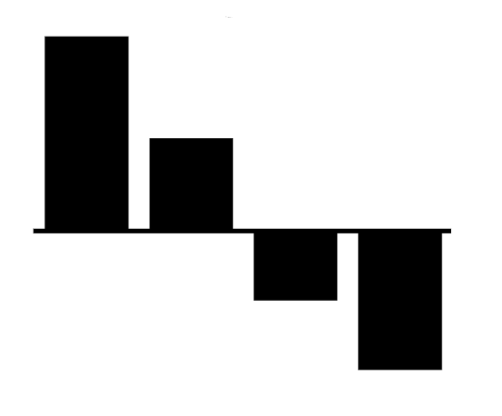
Optimized Marketing Plan
Detailed budget allocation impact
Marketplace & Mobile Ads
Increase marketplace and mobile budget allocation across all countries: lowest cost per click.
Analysis: Constraints & Diversification
Diversification in the campaign budget allocation due to constraints
Premium
Reduce budget allocation from Premium
Notes:
So what makes these change? Via our model, it shows marketplace and mobile have a significant low cost per click rate comparing to the premium one, which makes them work more efficiently on increase the quantities of impression. Hence new plan is focus on increase the budget in marketplace and mobile part by cutting the premium’s proportion.

Slide 7



Other Scenario: Korea Mobile Ads
Opportunity: Campaign should include Korean Mobile Ads
Advantages
Challenges
Solutions
Large number of mobile users
No internal data on CPM
Assume $ 0.40 CPM for Korean Mobile Ads
2nd highest market growth for Intel
Based on model’s sensitivity analysis
Increase number of clicks by 2000 clicks with the same budget
Notes:
Talk about the decision maker’s budget (help them allocate)

Slide 8
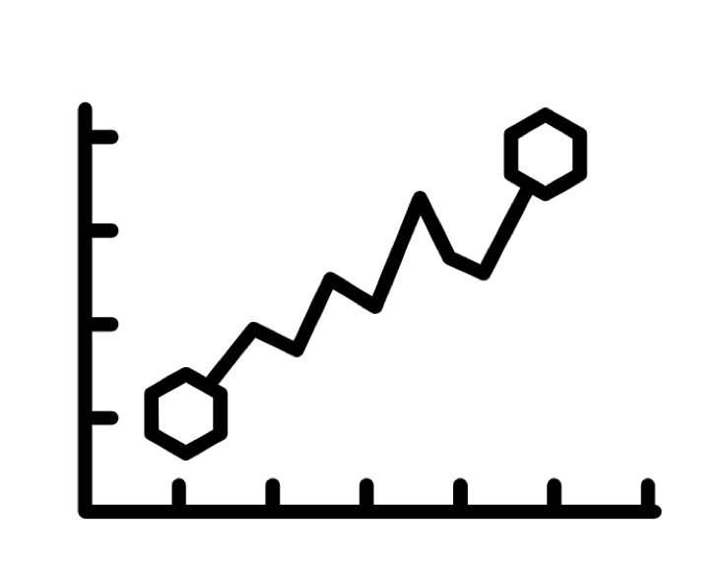


Key Takeaways & Further Considerations
Optimized Catch & Win Campaign
Korea Mobile Ads Opportunity
Based on internal data yields expected approx. 96,000 campaign clicks
Opportunity to increase clicks to approx. 98,000 with same budget
Campaign Timeline
Google Ads
Budget allocation to premium ads might need to increase if campaign is shorter
In 2012, CTR benchmarks for Google were higher than Facebook’s, therefore, limiting our marketing campaign on Facebook may not be ideal

Slide 9
Appendix

Slide 10
Appendix 1 – References

Slide 11
Appendix 2 – Sensitivity Analysis

